Slide 1

Query Optimization
Presented By:
Elizer Ponio Jr. Department of Computer Science
College of Computing and Information Technologies

Slide 2
Outline
What is Query Optimization?
Plan and a Quality of a Plan
Heuristic Optimization
Selectivity and Cost-based Optimization

Slide 3
What is Query Processing?
Query Optimization is a crucial aspect of database management that focuses on improving the performance of queries executed on a database system.
It involves selecting the most efficient execution plan for a given query, considering factors such as data access methods, join algorithms, and indexing strategies.
Query Optimization works by analyzing a query and generating multiple alternative execution plans.

Slide 4
What is Query Processing?
Each plan represents a different way to execute the query, utilizing different algorithms and access methods.
The optimizer then evaluates these plans based on cost estimates, which consider factors such as the amount of data to be processed, the complexity of the query, and the available hardware resources.
The optimizer selects the execution plan with the lowest estimated cost, aiming to minimize query execution time.

Slide 5
Query Optimisation
SQL
Canonical Translation
Annotated Relational Algebra
Heuristic optimisation
Transformed Logical Plan
Cost based optimisation
Physical Plan
Executable Code
Code Generation

Slide 6

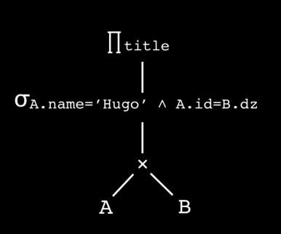
Overview of Query Optimizer
Declarative Query
Query Parser
Algebraic Expression
Contains DB Schemas and
Statistics
Catalog
Query Optimizer
Precompiled modules
Code Generation
Physical Query
Execution Plan
Query Plan Interpreter
Code Execution
Executable Program
Notes:
The Query Optimizer uses statistics to create query plans that improve query performance

Slide 7
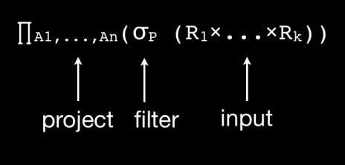
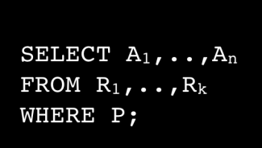
Canonical Translation
Query
Parser
In canonical translation, SQL is translated into relational algebra.

Slide 8
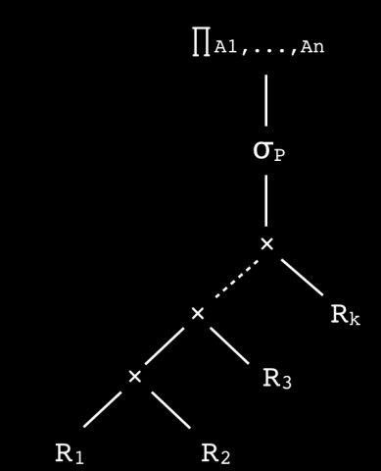

Canonical Translation
Represent relational algebra
to a tree

Slide 9
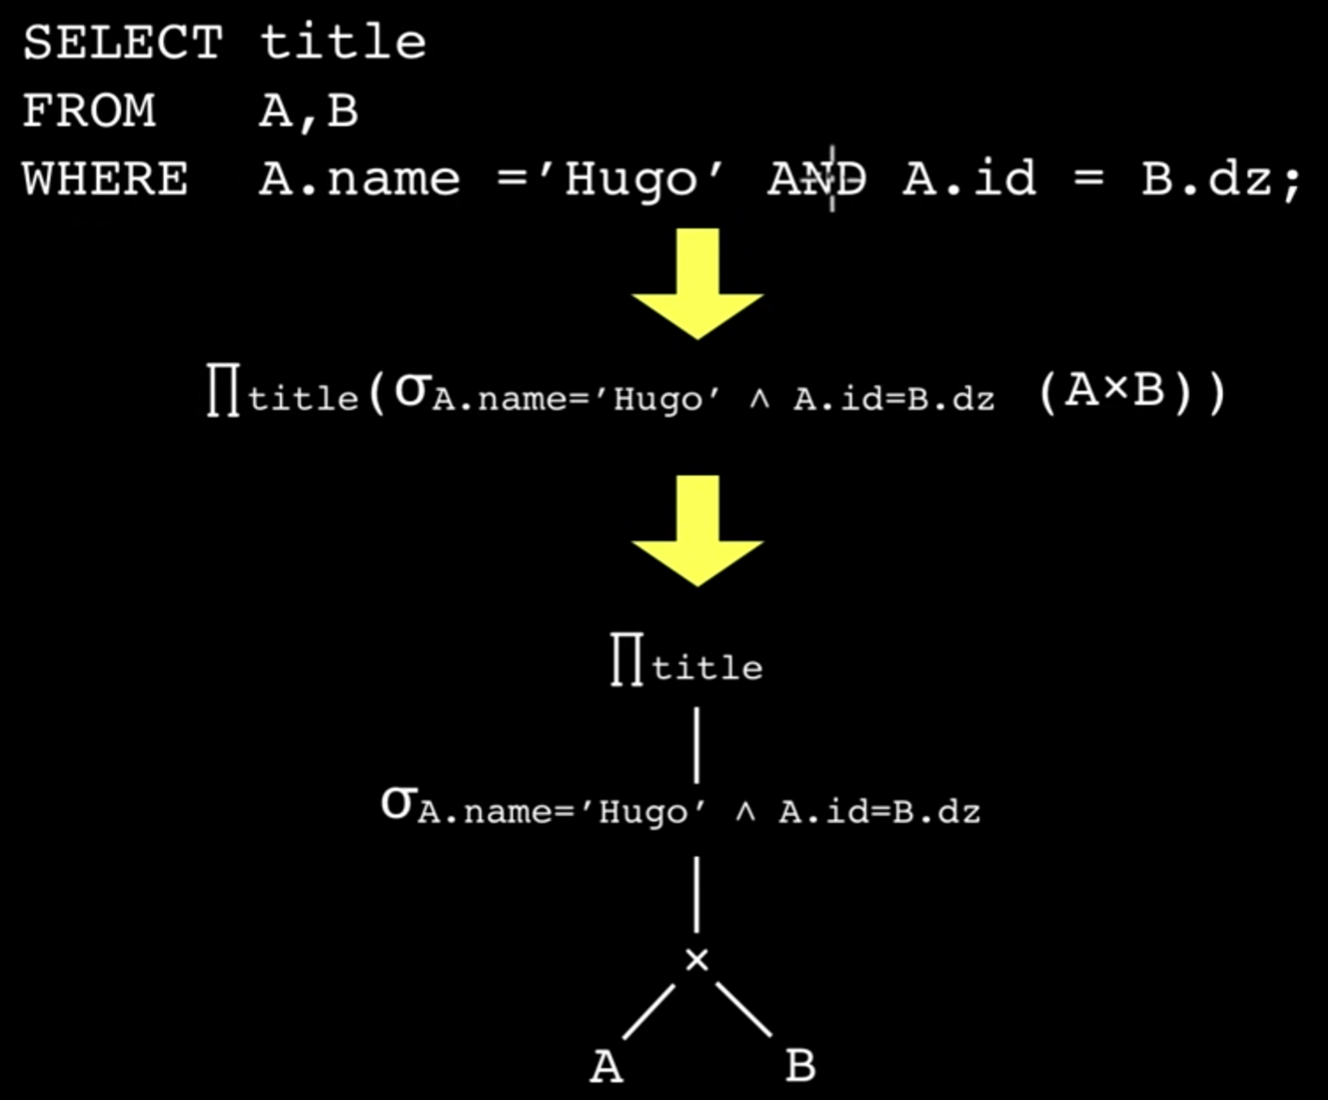
Apply transformation following
a transformation rule

Slide 10
Outline
What is Query Optimization?
Plan and a Quality of a Plan
Heuristic Optimization
Selectivity and Cost-based Optimization

Slide 11
Plan and a Quality of a Plan
Any valid relational algebra expression consisting of logical and or physical operators is called a plan.
An expression consisting only of logical operators is called a logical plan.
An expression consisting only of physical operations is called a physical plan

Slide 12
Plan and a Quality of a Plan
To determine the quality of a plan, we need to develop a function that can compute or estimate that quality.
Quality may be defined in various different ways: low runtime, low power consumption, little data is loaded from the network, etc.

Slide 13
Outline
What is Query Optimization?
Plan and a Quality of a Plan
Heuristic Optimization
Selectivity and Cost-based Optimization

Slide 14
Heuristic Optimisation
Heuristic optimisation iteratively transforms the canonical plan into a (hopefully) better logical plan using rules.
Such a rule-based transformation never changes the outcome of the plan.
Attempts to transform the plan are made until none of the heuristic rules are applicable.
Only rules that always reduce (well, let’s say in 99.99% of the cases) the costs under a given cost model are applied.

Slide 15
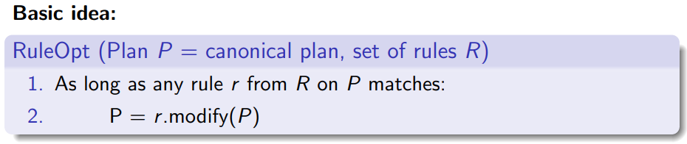
Heuristic Optimisation

Slide 16
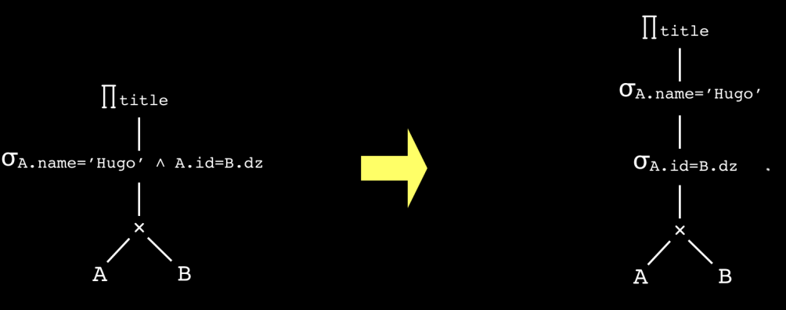
Break Up Predicates

Slide 17
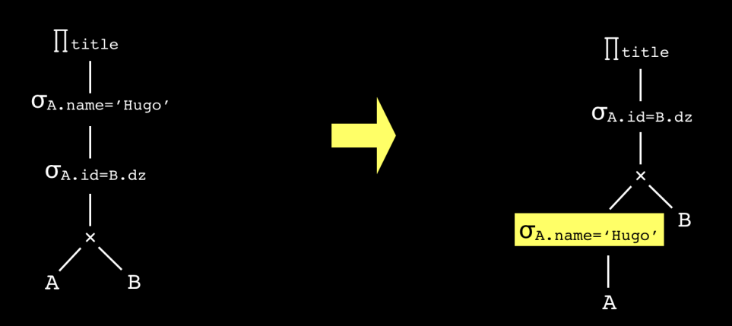
Push Down Selections

Slide 18
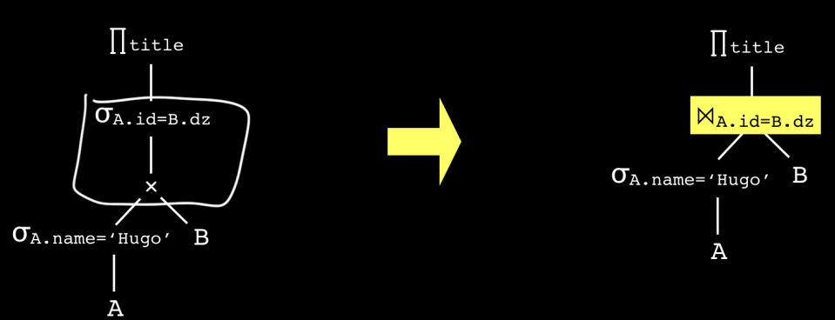
Build Joins

Slide 19
Outline
What is Query Optimization?
Plan and a Quality of a Plan
Heuristic Optimization
Selectivity and Cost-based Optimization

Slide 20
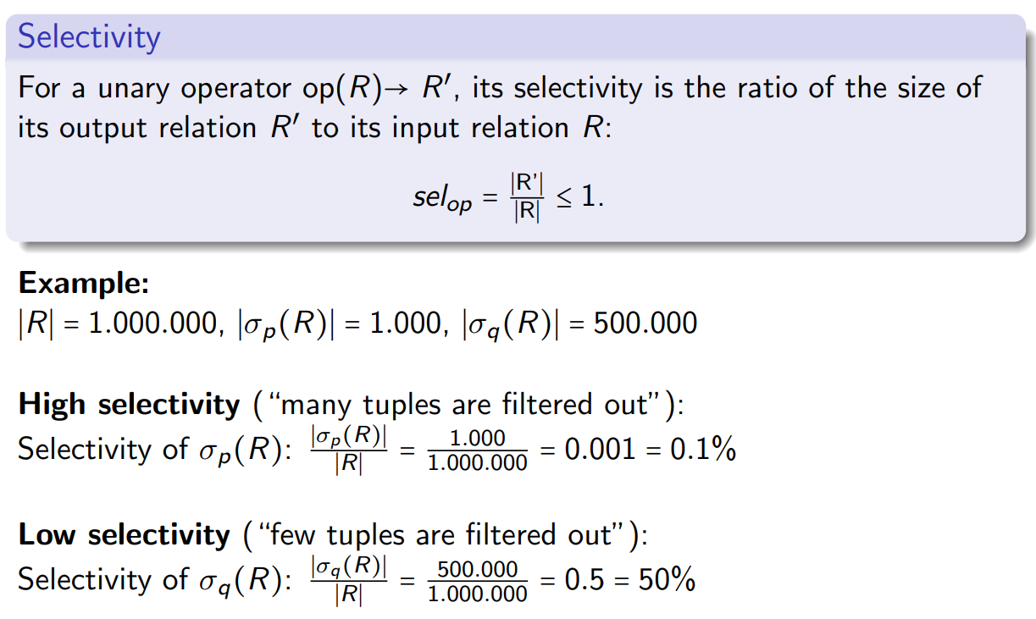
Selectivity

Slide 21
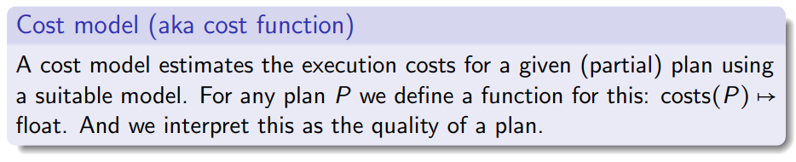
Cost Models

Slide 22
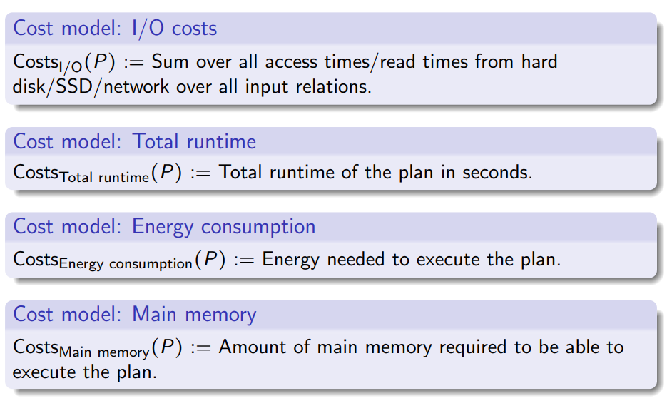
Cost Models

